Slide 1
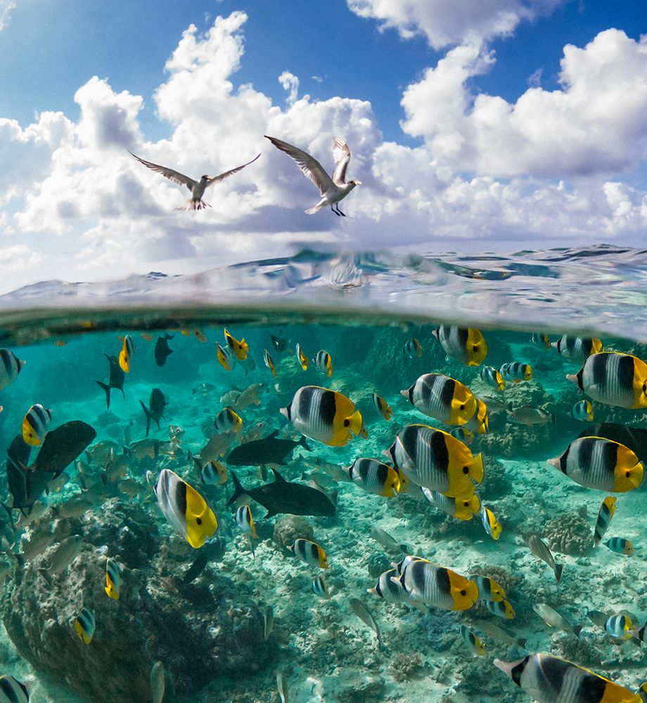





Team 1
سمك

Slide 2
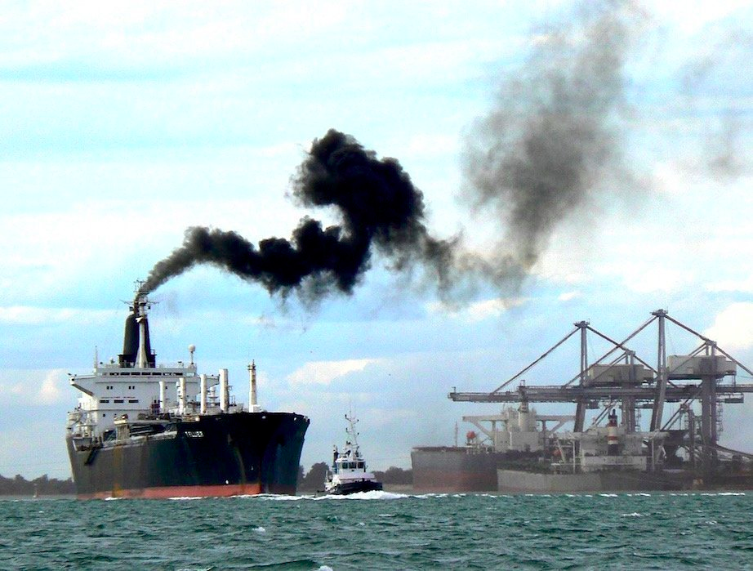
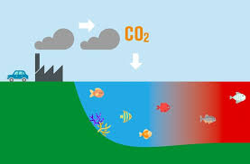
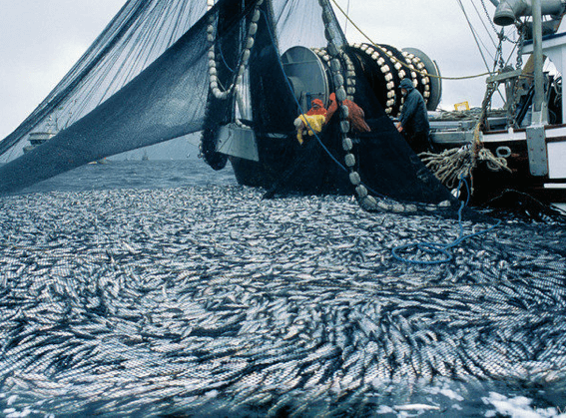
The unsustainability of the current industrial fishing
Pollution
Ocean acidification
Ecosystem disruption
50 billion liters of fuel each year
30% increase since the industrial revolution
69% drop in marine vertebrate populations since 1970

Slide 3




SDG 6
Clean Water and Sanitation
Not achieved by any country
SDG 14
Life Below Water
18 countries out of 22 in the Arab region are “red”

Slide 4
Why is this problem so hard to solve?

Slide 5
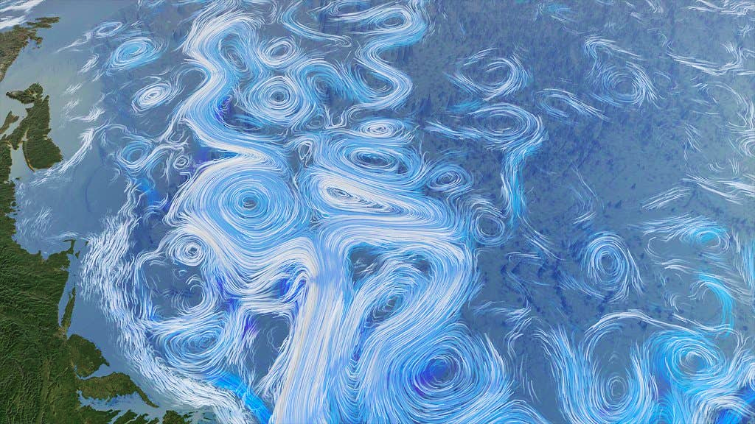
Chaotic systems are extremely hard to predict!
Suboptimal fishing routes
High fuel consumption
Pollution
Sea & fish dynamics
difficult to predict
Computationally hard on classical computers!
Finding optimal route through fishing spots
“Traveling Salesperson Problem” (TSP)
NP-Hard on classical computers

Slide 6
Here comes samaQ!

Slide 7
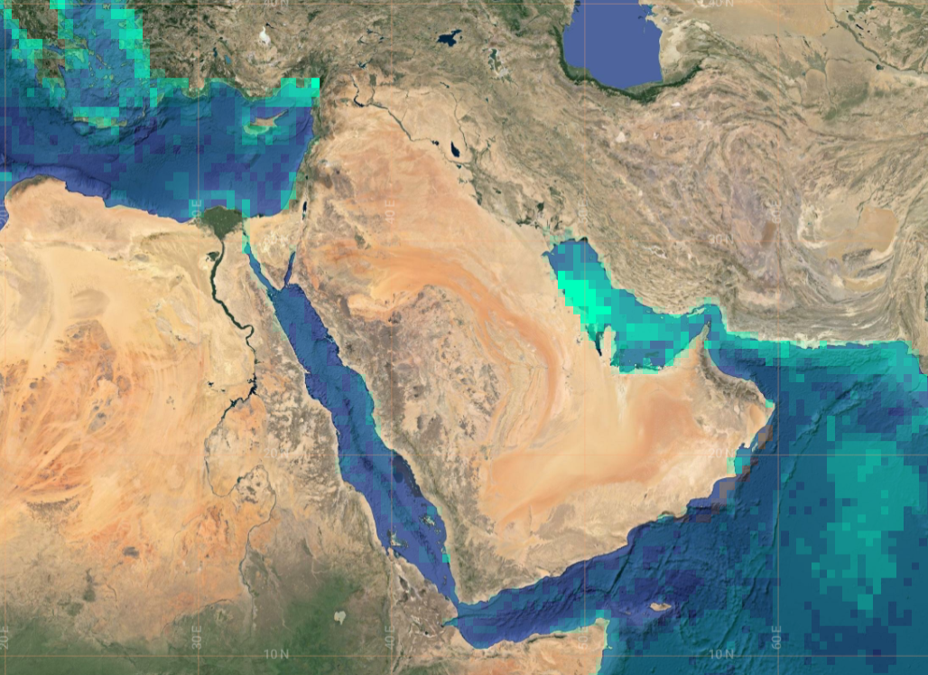
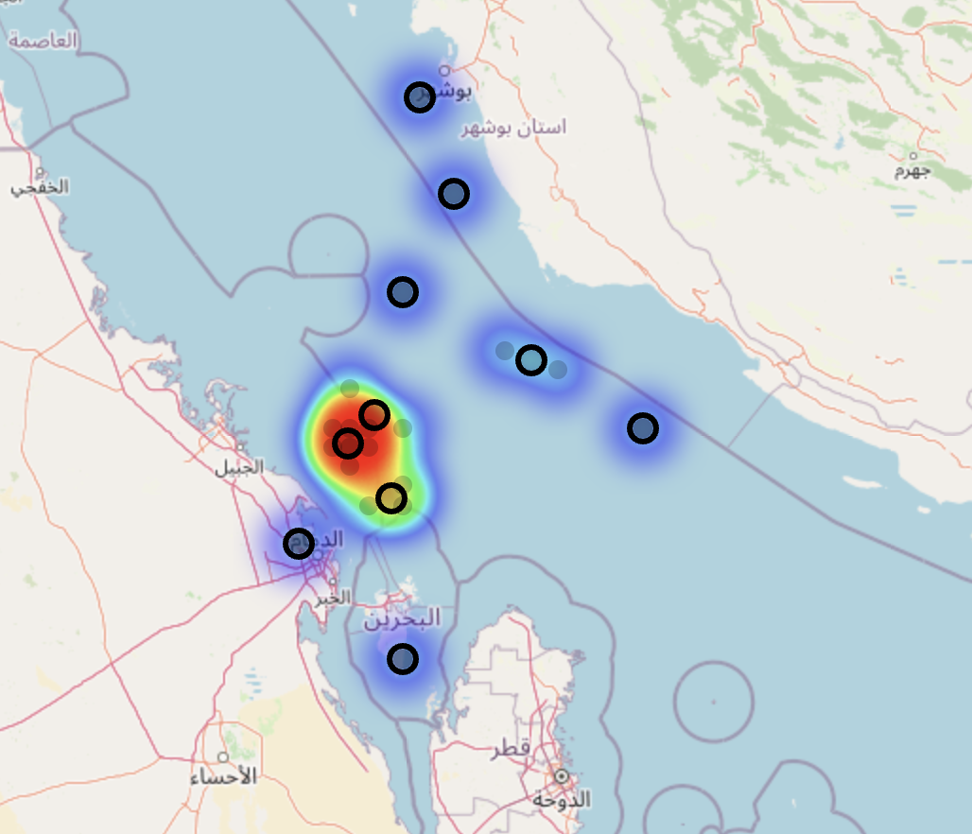
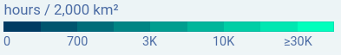
1 Using AI to find the optimal fishing spots
Continuous fishing spot identification
Historical fishing data
k-means clustering
Fishing activity

Slide 8
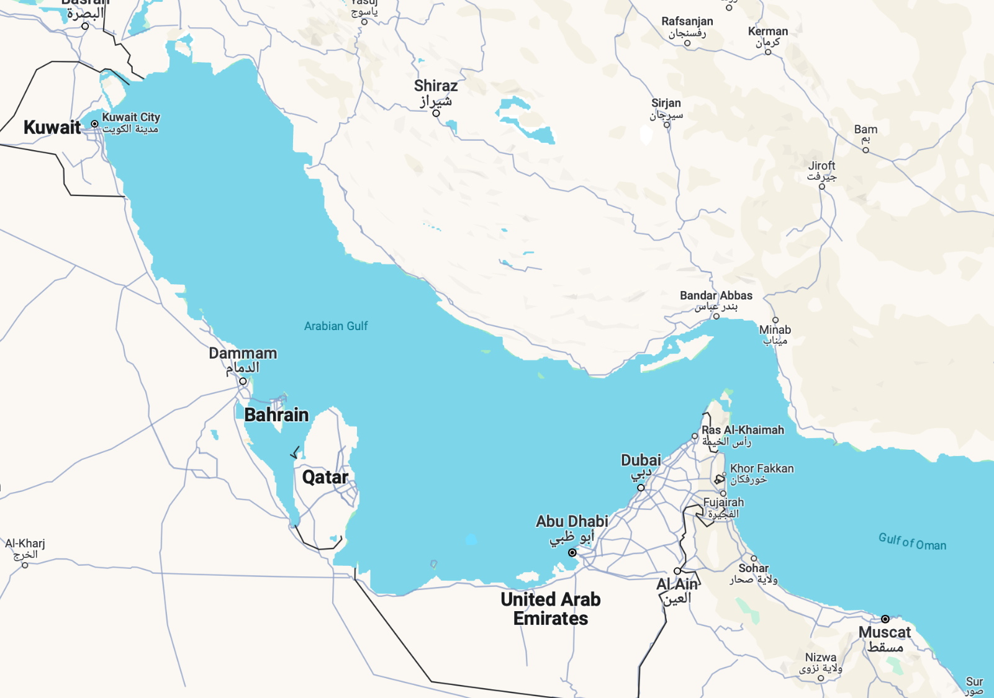
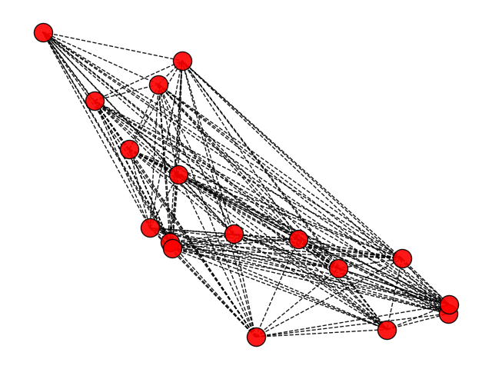
2 Using QC to find the best fishing route
Map fishing spots into graph
Assign edge weights according to environmental impact
Optimal route = TSP

Slide 9
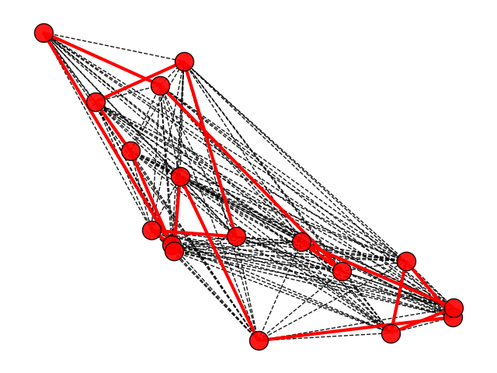

2 Using QC to find the best fishing route
Optimal route = TSP
Map problem to QUBO
Find optimal route as the ground state using Quantum Annealing
Polynomial time!

Slide 10
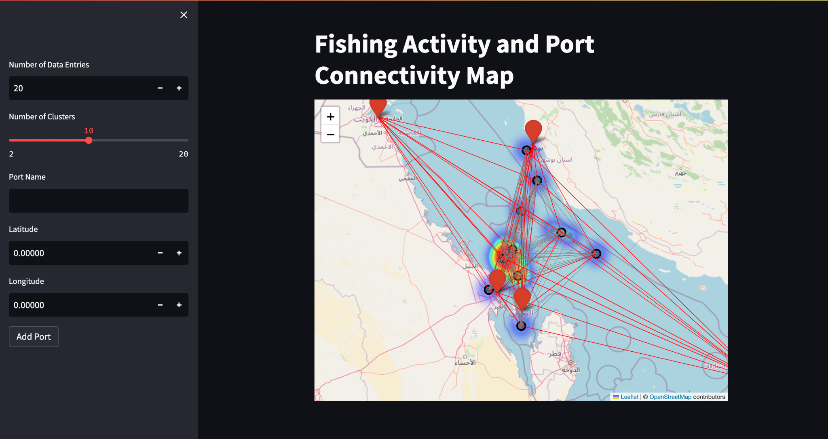

Slide 11
Impact
Quantum Annealing is
already available on the market
further developed than universal QC
Environment & society
prediction of best fishing spots
fuel sparing ⇒ less pollution
avoid endangered & fish-depleted regions
better food-related health
Our solution can be applied starting from TODAY

Slide 12

Roadmap
Long term: Explore and incorporate additional quantum approaches into our pipeline
Short term: Expand the method beyond the Persian Gulf region

Slide 13


Market Size
Potential Partners
TAM
Governments
Non-governmental organisations NGOs
Marine Data company
DWave
6.1 Bn
1.68 Bn
SAM
186 M
SOM

Slide 14
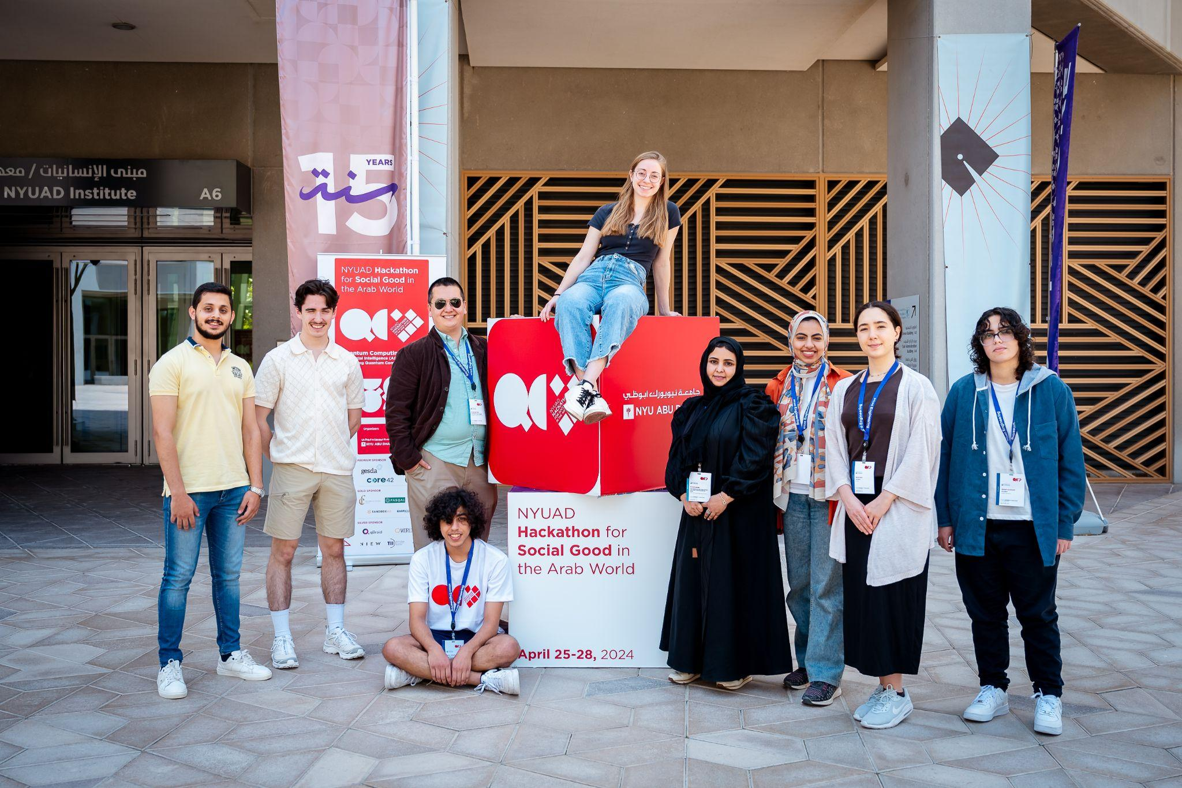







Elena
Mahmoud
Julien
Oliver
Nada
Helin
Rahaf
Elham
Pavly

Slide 15
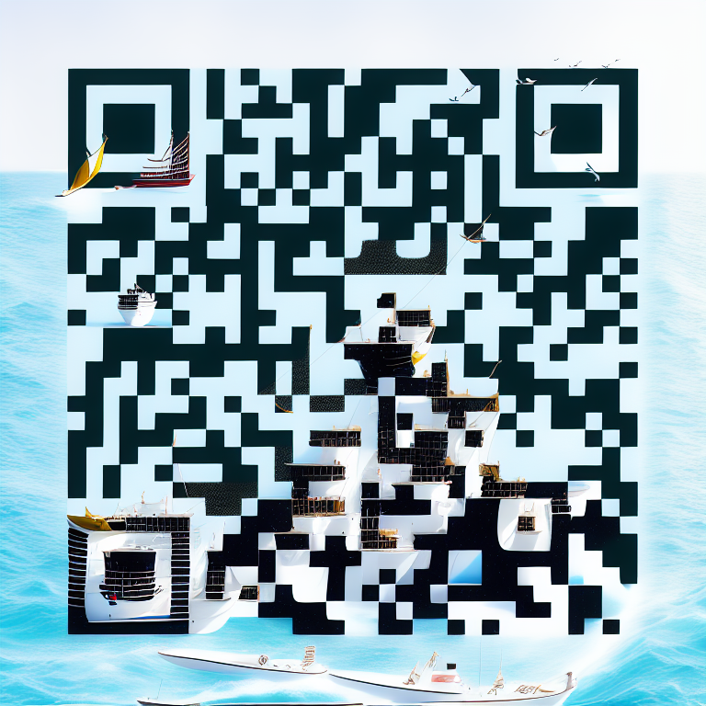
To learn more about our model and the issue visit our website!
Thank You!

Slide 16
















Hosted by
Premium Sponsor
Gold Sponsor
Silver Sponsor and Partner

Slide 17
Business
Market Size
Potential Partners
TAM: 6.1 Bn USD
Saving health cost from a more healthy population
Governments
Non-governmental organisations NGOs
Marine Data company
DWave

Slide 18
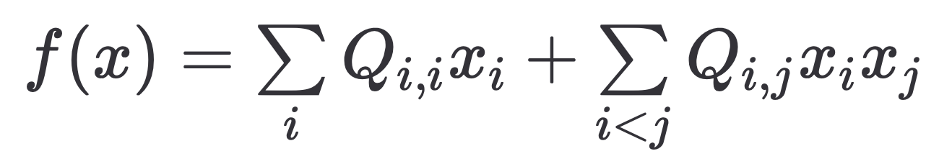
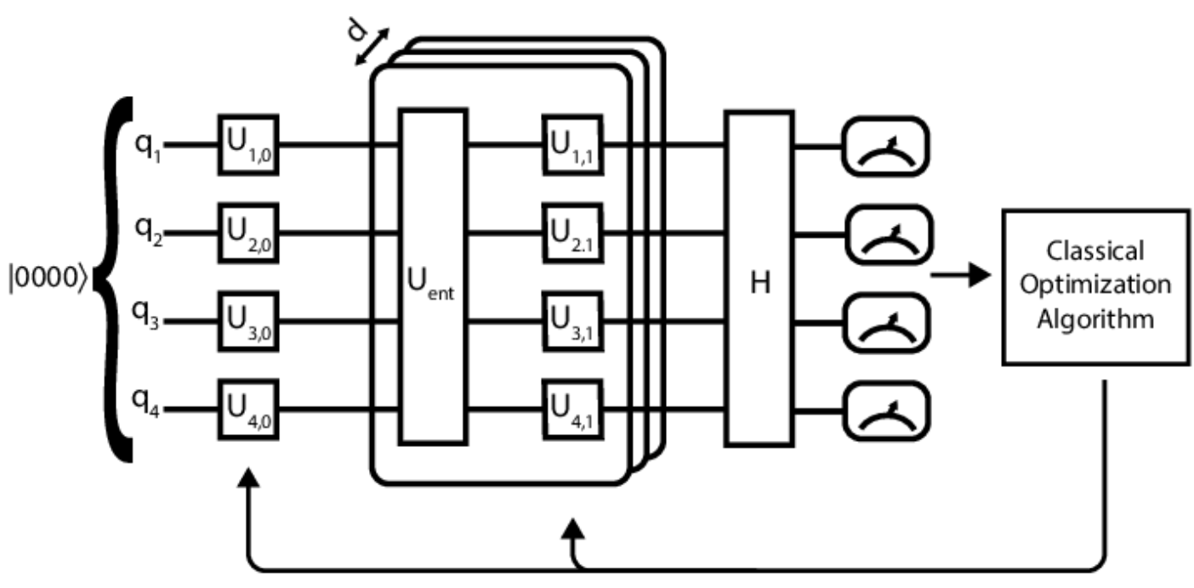
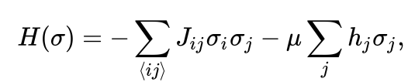

3 Quantum Implementation
Quantum Annealing
QUBO formulation
Map to the Ising Hamiltonian
Use Quantum Annealing to solve TSP

Slide 19

The unsustainability of the current industrial fishing
Human food poisoning & famines
Water pollution
Ocean acidification
Death of fishes

